Slide 1


PREPARED BY:
NAME: AYUSH SHAH
ENROLLMENT NO: 21002170110167
ROLLNO: 134

Slide 2
WHAT IS PING PONG GAME?
This Python code simply resembles the old classic 90’s Popular game “Ping Pong Ball”.
The Game is played between 2 players, Both players have a controller that helps to move the paddle up and down to hit the ping pong ball.
The Aim of the players is to score points by hitting the ball in the opponent player’s goal post.
The Code uses a turtle module to create graphics and animate the game.
To provide background music and to make it more realistic wind sound module is used.

Slide 3
CONSTRUCTION OF GAME
The Game is created by setting up paddles, balls, and scorecards.
Keyboard bindings are set up to allow players to have easy control of their paddles.
The Game is built in a loop that continuously updates the screen, and checks for collisions with the paddles and borders of the screen to update the score.
If any player scores a point, the ball is reset to the screen and the score is updated.
Games continues until a player reaches

Slide 4
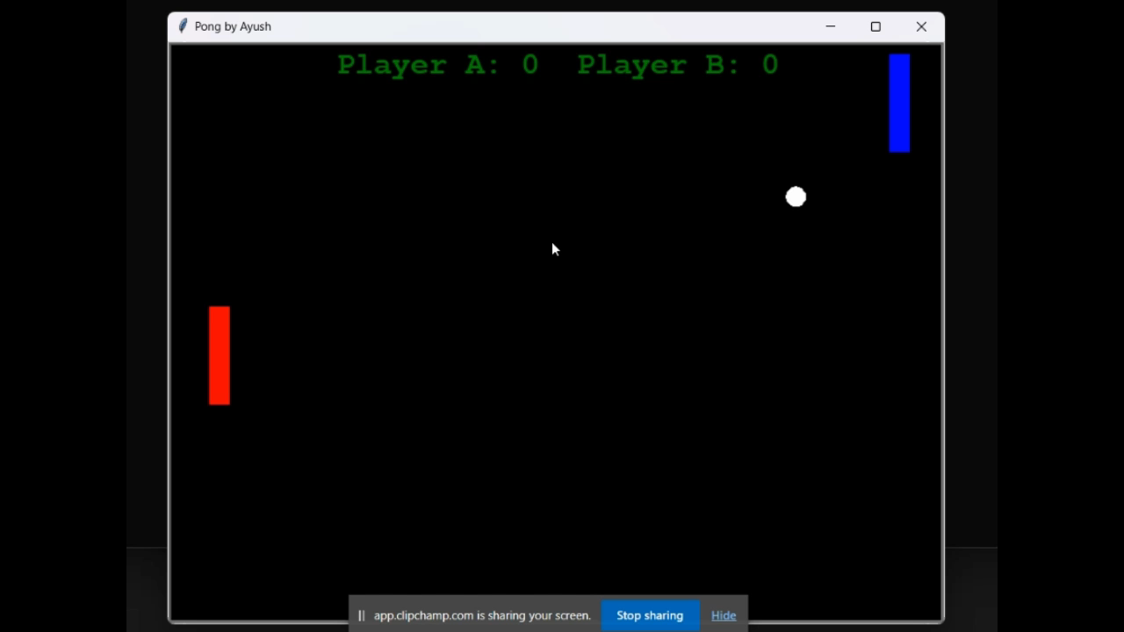
OUTPUT OF CODE:

Slide 5
THANK YOU

